Slide 1
Securing multiple ecosystems benefit through sustainable land management
in the productive but degraded landscapes of South Africa
ASSESSING LAND DEGRADATION THROUGH LAND USE/LAND COVER CHANGE IMPACTS AND SOCIO-ECOLOGICAL ANALYSIS IN THE RURAL SEMI-ARID AREA OF THE GREATER SEKHUKHUNE DISTRICT MUNICIPALITY, SOUTH AFRICA
Juniet Kgaphola
Council for Scientific and Industrial Research - CSIR
University of KwaZulu Natal

Slide 2
Outline
Introduction/Background
Statement of the problem
Objectives
Methodology/Implementation Plan/Activities
Final/Preliminary Results/Outputs
Conclusion/Expected outcomes
Expected/Proposed Application Areas
Stakeholders and Users

Slide 3
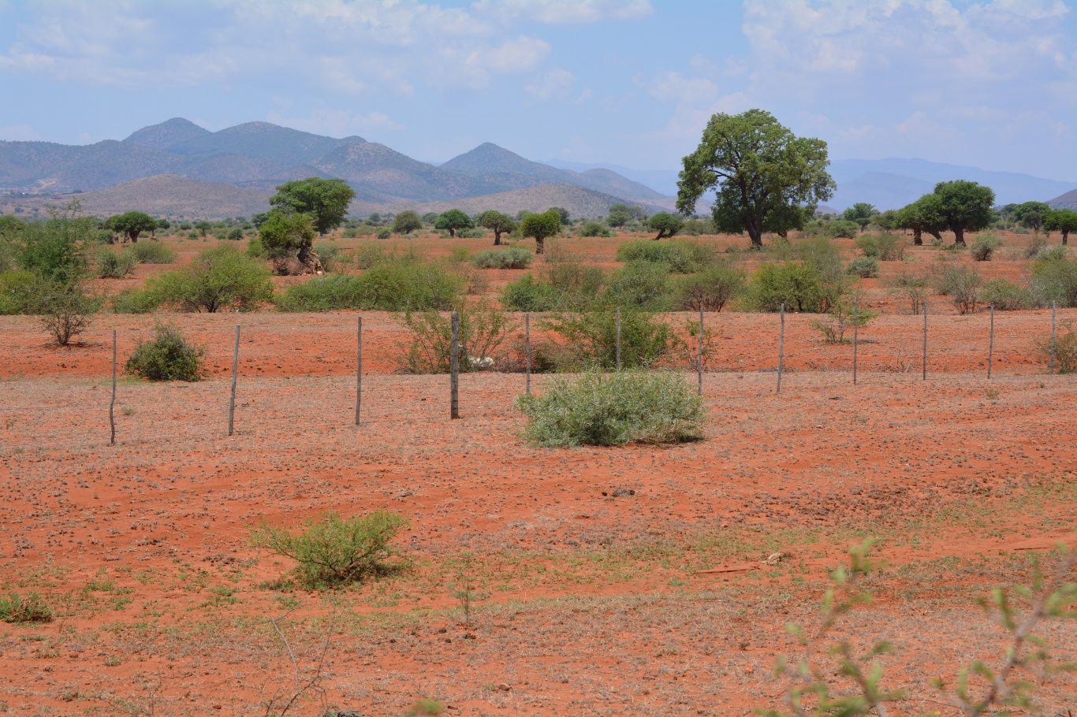
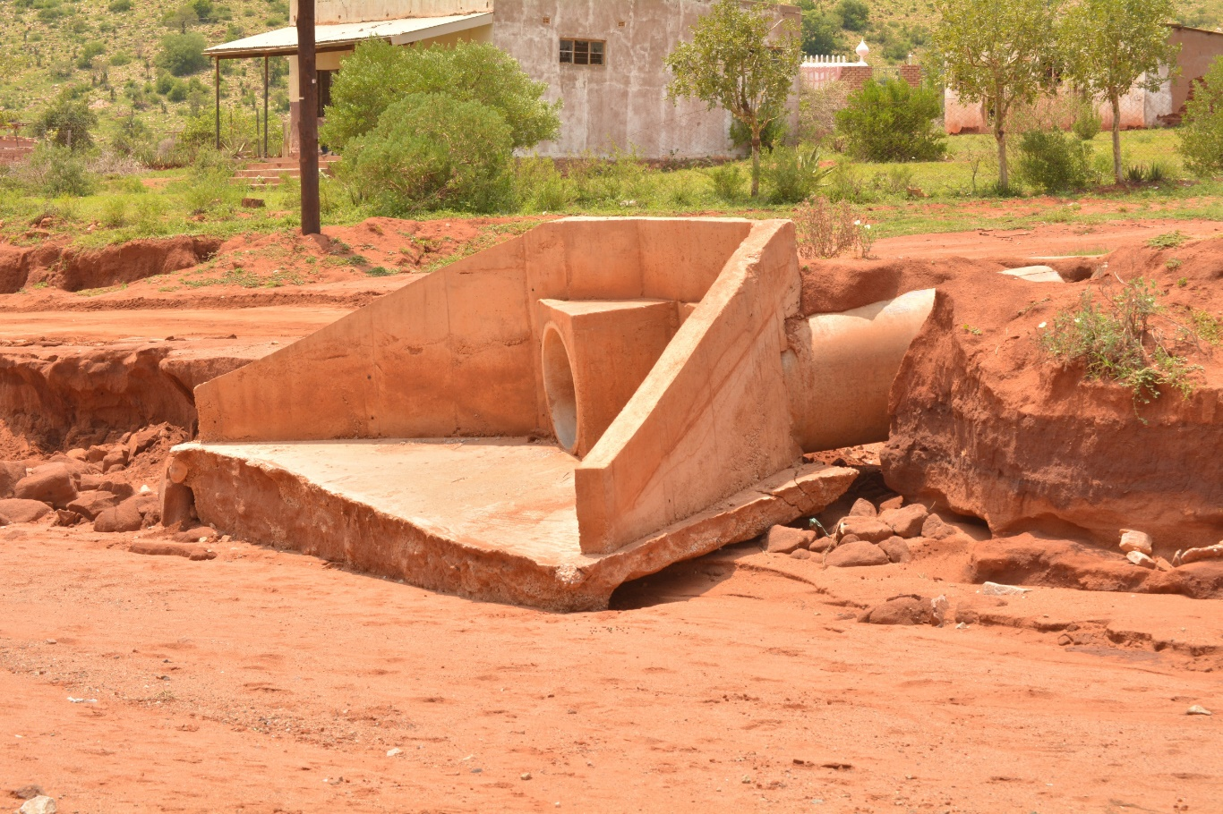
Introduction/Background
Land Degradation (LD) - major global environmental problem that impacts socio-ecological systems (SES) and livelihoods of vulnerable communities.
Land degradation- complex phenomenon particularly in rural developing worlds.
Recent rates, extent and intensity of LULC Change (LULCC) are far greater than were in the past.
In semi-arid regions, climate variability and poor land practices accelerate LD process i.e., more than 70% of the land in South Africa is intensively degraded.
Complex land use management system and tensions in communal areas of SA.

Slide 4
Objectives/Statement of the Problem
Aim: To understand the driving mechanism of LULCC and the influence of the latter on land degradation in the GSDM
Objectives:
To assess the evolution of LULC from 1990 to 2019 and its impacts on LD using multispectral satellite imagery,
To distinguish human-induced land degradation from rainfall using the RESTREND method from 1990 to 2019 and
To identify drivers of LD and SLM interventions (Responses) using SES analysis of DPSCR4 and LDN frameworks.

Slide 5
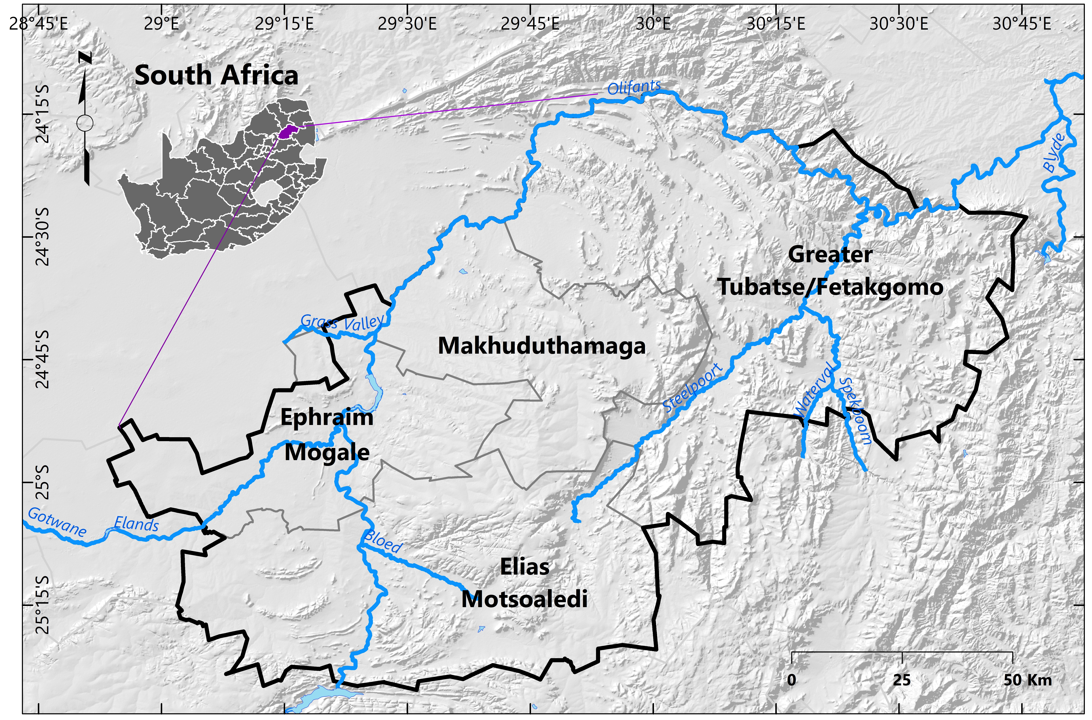
Methodology (Data & Methods), Implementation Plan/Activities
Obj 1: Evolution of LULC 1990- 2019
Obj 3: SES DPSCR₄
Obj 2: RESTREND
Data Collection: NDVI (NOAA-AVHRR sensors), Rainfall (PERSIANN-CDR)
Methods and Analysis: Socio-Ecological System (SES) DPSCR₄ Framework
Data Collection: Key Informants interviews (Semi-structured), Workshops (Tribal Authority & Local Herders)
Data collection: Wet and dry season Landsat 5TM,7ETM+, 8 Oli, five-year interval
Methods: Classification scheme, Supervised classification, maximum likelihood, Accuracy Assessment
Data Analysis: LD Indicator: Change Detection
Methods: Regression, Mann-Kendall trend and residuals
Data Analysis: Residual trend Analysis
Study Area: Rural Semi-arid environment
South Africa, Limpopo Province, The Greater Sekhukhune District Municipality

Slide 6
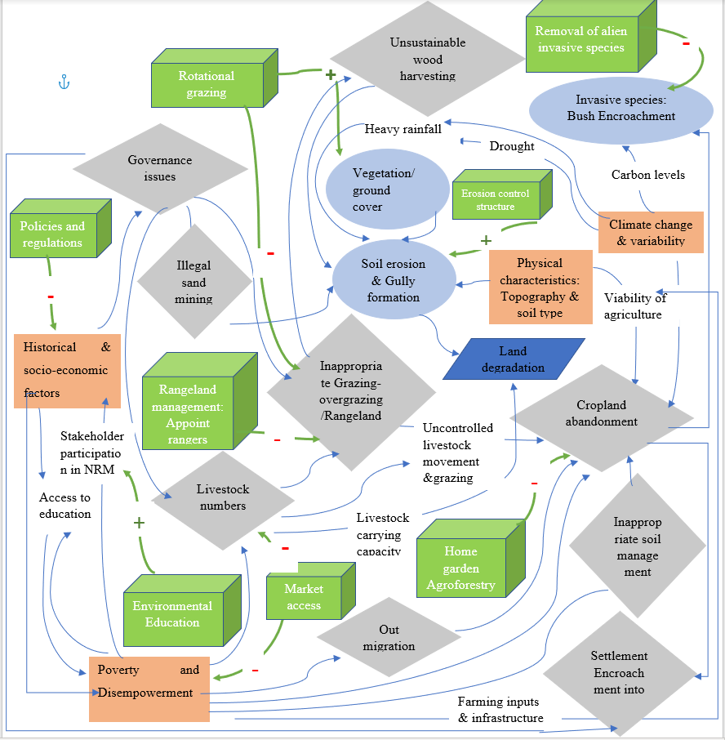
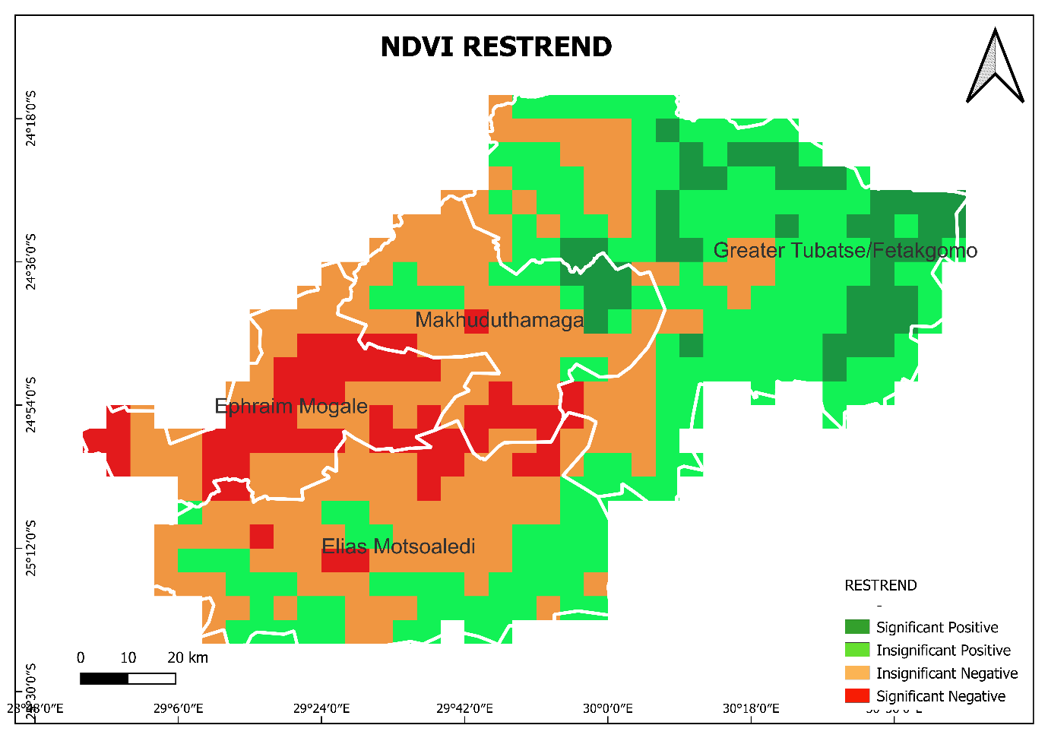
Final or Preliminary Results/Outputs
SES DPSCR₄
Rank | From Class name | To Class name | Period | Season | Area (Ha) | %
1 | Shrub/grassland | Bare soil/exposed rock | 2015-2019 | Dry | 129255.85 | 9.55
2 | Thicket/dense bush | Shrub/grassland | 2010-2015 | Wet | 110625.63 | 8.18
3 | Shrub/grassland | Bare soil/exposed rock | 2010-2015 | Wet | 109736.63 | 8.11
4 | Shrub/grassland | Bare soil/exposed rock | 1995-1999 | Dry | 92186.56 | 6.81
5 | Shrub/grassland | Eroded Land | 2005-2010 | Dry | 79494.00 | 5.88
6 | Thicket/dense bush | Bare soil/exposed rock | 1990-1995 | Dry | 76749.93 | 5.67

Slide 7
Conclusion/Expected Outcomes
Synergistic impact of climate variability and extreme weather events
Natural drivers i.e., topography and duplex dispersive soils expose the district to erosion
Main drivers of LULCC and LD- Decline in rainfall, climate variability, exacerbated by anthropogenic activities
Efforts made to address LD in the past- Vandalism, lack of accountability and improper land use remains a challenge.
Study highlighted importance of EO and Integrated approach:
Long-term spatio-temporal data of LULCC, RESTREND and SES DPSCR4- revealed a major issue of bush encroachment that affects the ecosystem productivity and livelihoods of vulnerable communities.
The study recommends that bush encroachment to be studied further to curb land degradation as this hinders livestock grazing i.e., affecting livelihoods, and has negative consequences on the ecosystem.
Need for sense of urgency from the government, tribal authority as custodians of natural resources and land users

Slide 8
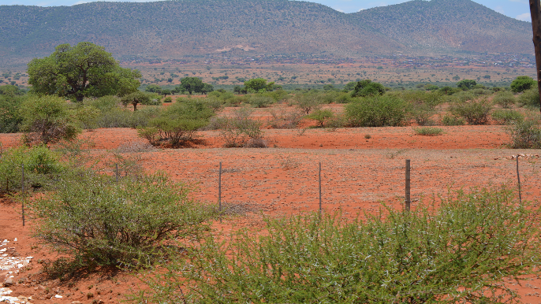
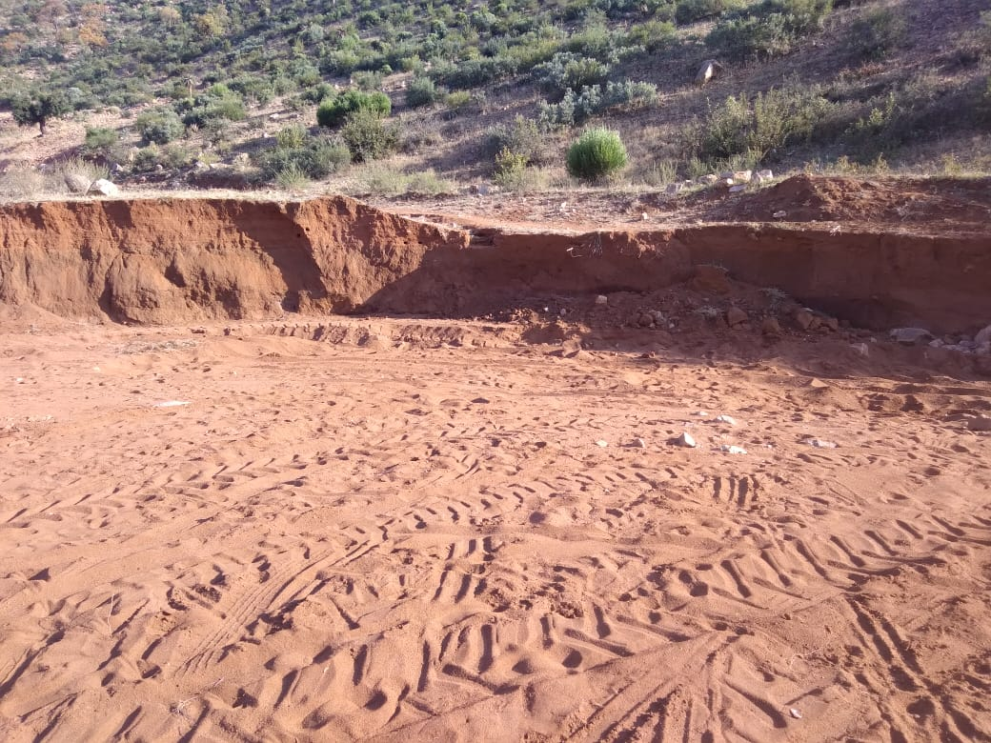
Expected/proposed application areas of the research/product/tool/service
LULCC over a long period: Tool to assess LD and basis/foundation for understanding long-term changes as LD is a slow-onset process
RESTREND: Identifies the driving factor at a cell level- informs land users, policymakers, and natural resource managers to identify specific SLM intervention measures that effectively address LD.
The application of DPSCR4 and LDN frameworks provides a synthesis and clear comprehension of the interrelated drivers of degradation and integrated land use plan to produce win-win benefits to improve the landscape conditions and sustainable livelihoods.

Slide 9
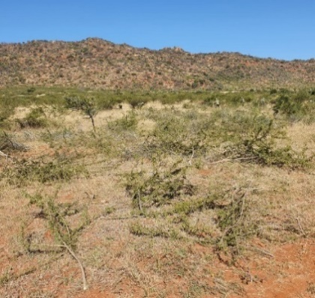
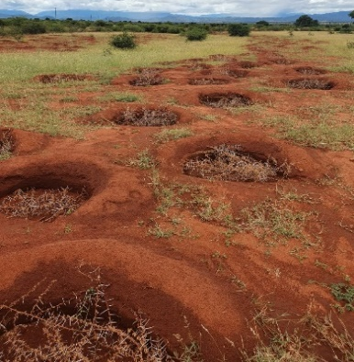
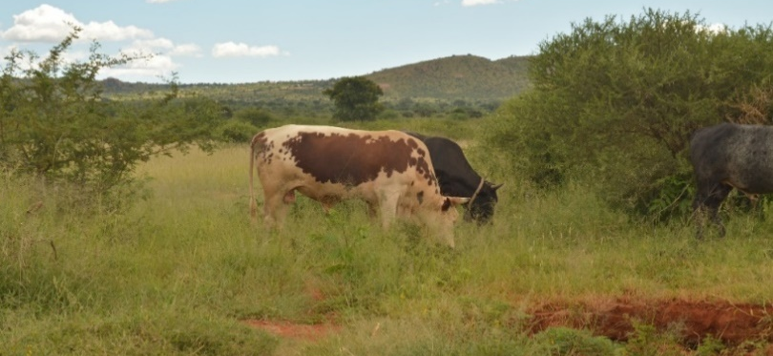
Collaborators, Stakeholders and Users
Limpopo Department of Agriculture and Rural Development
Department of Forestry, Fisheries, and the Environment
Cooperative Governance and Traditional Affairs (COGTA)- 17 Traditional authorities in Sekhukhune District
Mphanama and Ga-Radingwana communities- Local Herders; application of Agroforestry by communities, 5 local primary and secondary schools; and Rangeland rehabilitation
One of the most degraded areas in the district identified using EO: Land rehabilitation of the grazing land of Mphanama under the UNDP GEF5 SLM project (Left to right) brush packing and ponding to increase the vegetative recruitment and the survival rate of regenerating plants and of seeded grass

Slide 10
Acknowledgement
Motsoko Juniet Kgaphola¹²
Abel Ramoelo²
John Odindi¹
Jean-Marc Mwenge Kahinda²
Ashwell Seetal²
Connie Musvoto²
(1) CSIR, Smart Places, P.O. Box 395, Pretoria 0001, South Africa
(2) School of Agricultural, Earth and Environmental Sciences, University of KwaZulu Natal, Scottsville 3209, Pietermaritzburg, South Africa
(3) Centre for Environmental Studies, Department of Geography, Geoinformatics and
Meteorology, University of Pretoria, Pretoria, South Africa
MKgaphola1@csir.co.za

Slide 11
Thank you
Questions?

